Slide 1

GREEN ICT
Prepared by : Computer Science Department
University of Mauritius
Research on Green ICT

Slide 2
Green ICT
Also known as Green Computing
Involves environmental sustainable technology and processes :
  Designing, manufacturing, using and disposing
  Minimal or no impact to environment : 3P’s (People, Planet, Profit)

Slide 3

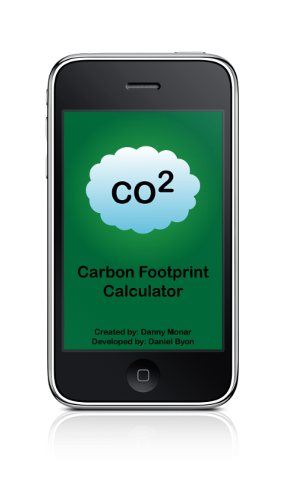

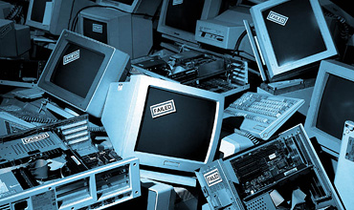
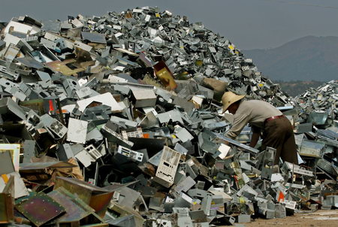
Challenges
"Moore's law“: Gordon Moore, co-founder Intel, predicted that computer processing power roughly doubles every two years.
ICT accounts for 2% of of global CO2 Emission
Approx 50 million tons of e-trash generated a year worldwide, according to the UN Environment Programme.
‘ state-of-the-art’ machines threatened by obsolescence.

Slide 4
Green ICT
Comprise
  initiatives and strategies that reduce the environmental footprint of technology.
Reduce
  energy use and consumables, including hardware, electricity, fuel and paper– among others
Produce
  Because of these reductions, Green ICT initiatives also produce cost savings in energy use, purchases, management and support, in addition to environmental benefits.
Address
  Beyond cost savings and environmental benefits, some initiatives may address stakeholder and regulatory needs and demands

Slide 5
Factors Driving the Implementation of Green ICT
1
Decreased consumables use
2
Increased features and functionality for the business
Decreased expenses or investments
3
Meeting customers’ demands
Realizing credits or rebates from local utilities or governments
Decreased electricity use

Slide 6
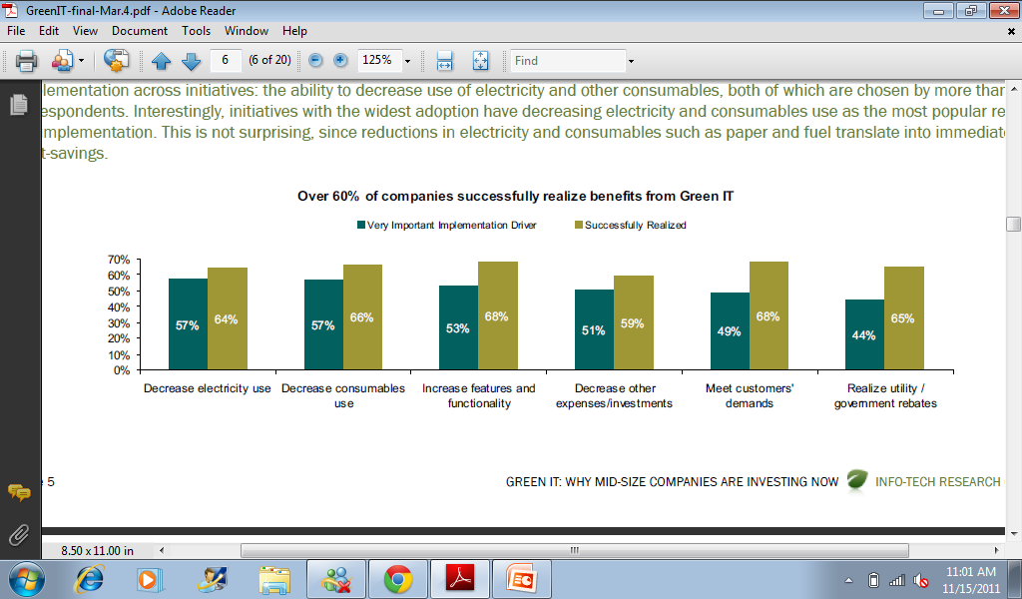
Successful benefits upon implementation of the key Green ICT Drivers

Slide 7
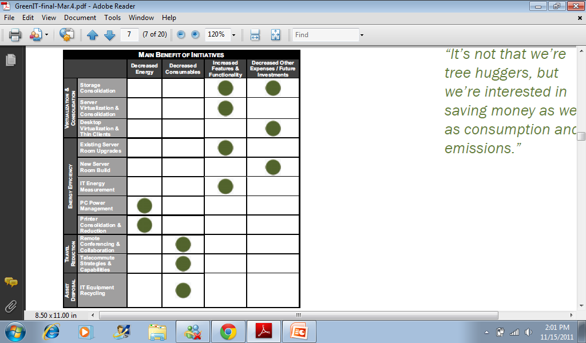
Green ICT Outcome

Slide 8
Research Areas
Research in Green ICT is geared towards the following :
Education and Awareness & Policy building
ICT technology to reduce energy consumption

Slide 9
Research trends among ICT users
Corporate
Backend (Power management, data center design, server virtualisation, green metrics, use of renewable energy sources
Frontend (Training, e-waste enlightenment, paperless office, double side printing)
Branding and promotions to include Triple P parameter
Home Users
Increase education/ awareness

Slide 10

Creating Awareness
Shout it out
Think Channel
Educate
Play with others
Live it

Slide 11

Green ICT Initiative in Corporate World -Symantec Green ICT Initiative Survey
Surveyed 426 companies in North America and a total of 1,052 worldwide on GREEN IT Initiative and Strategies

Slide 12
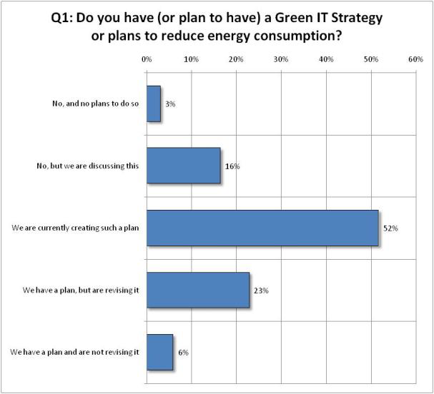
Results of Symantec Survey
52% are the companies which have been surveyed are working on Green ICT strategy plan

Slide 13
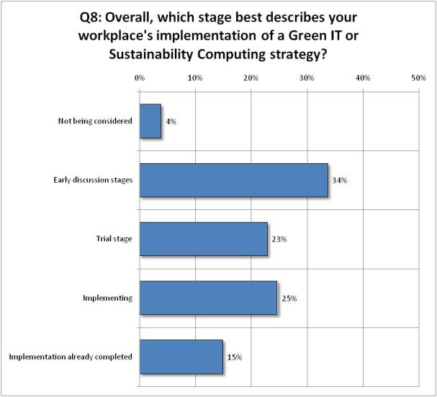
Results of Symantec Survey
34% are their early discussion stage regarding the implementation of their stragegy
21% are on trial stage
25 % are implementing
15% have completed the implementation

Slide 14
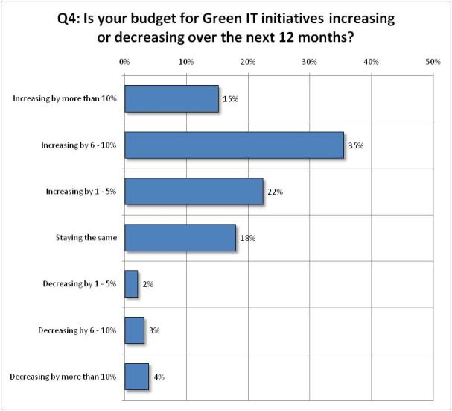
Results of Symantec Survey
35% are the companies have increased their budget by 6 to 10%

Slide 15
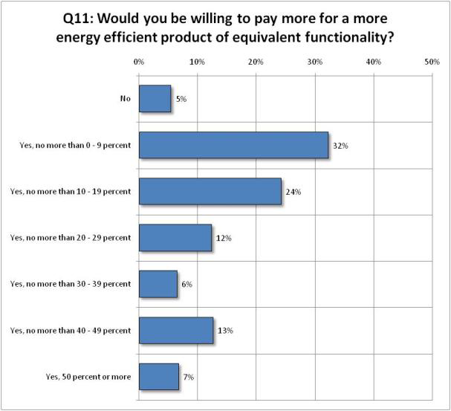
Results of Symantec Survey
32% are the companies are interested to pay 0-9% more on energy efficient products while 24% will pay 10-19% more

Slide 16
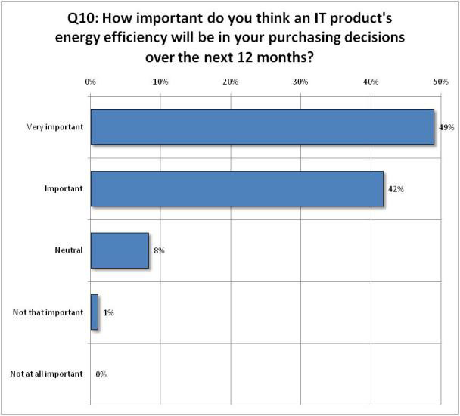
Results of Symantec Survey
49% of companies think of purchasing an IT product which is energy efficient within the next 12 months

Slide 17
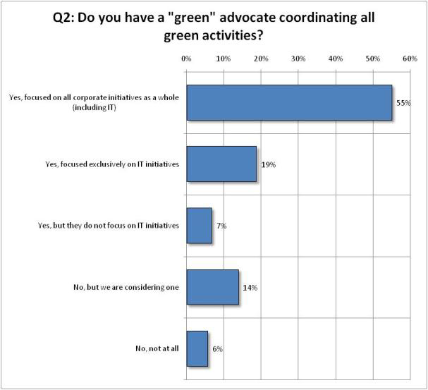
Results of Symantec Survey
55% of companies focused on all corporate initiatives as a whole to go green while 19% focuses on IT initiatives only

Slide 18
Summary of Results
Green ICT is now an “ESSENTIAL”
Green ICT budget are rising
IT willing to pay premium for Green Equipment
IT at the heart of Enterprise Green effort
Green ICT initiatives is more of a priority

Slide 19
ICT Going Green
server virtualization consolidation,
storage consolidation
desktop virtualization
existing server room upgrades
new server room builds
ICT energy measurement
PC power management
printer consolidation
remote conferencing
telecommuting
ICT equipment recycling

Slide 20
ICT Going Green
Green Communication Technology
Research focus : decreasing energy consumption and CO2 transmission in communication and networking devices
Green Computing Technology
Research focus : energy consumption and conservation in data centers, green storage , green cloud
Smart Grid and Application
Research Focus : Smart Grid, Green Middleware, Semantic Integration

Slide 21
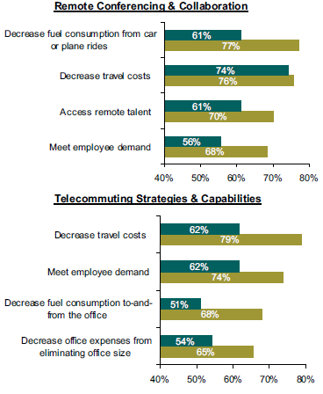
Research in Green Communication Technology
Remote Conferencing & Collaboration
Online collaboration environments.
Telecommuting Strategy & Capabilities
Virtual Private Network (VPN), remote access, and unified or voice
communications capabilities to enable access from home and other remote locations.
Policies and strategies allowing or encouraging employees to work from home.

Slide 22
Popular Initiatives
remote conferencing and telecommuting projects
  yield immediate cost reduction benefits along with a reduced environmental footprint
  BENEFITS:
Cost-efficiency,
Ease of management
Reduction in energy use

Slide 23
Research in Green Communication Technology
other areas
Evolving Communications Architectures
Green Wireless Communication
Energy Efficient Routing
Relay selection strategies for Green Communication
Energy efficient packet forwarding
Energy efficient networking games

Slide 24
Research in Green Computing Technology
Storage Consolidation & Server Virtualization
Desktop Virtualization and Thin Client
Printer Consolidation
Measuring Energy Usage of ICT equipment
Disposal of ICT equipment

Slide 25
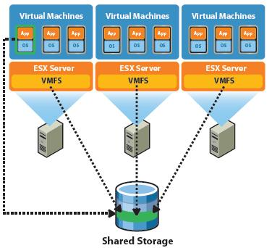
Storage Consolidation & Server Virtualization
Decrease the overall number of devices running in the server room
Decrease the energy required to run servers and storage, along with the associated cost and greenhouse gas emissions.
Decrease the cost of future investments in physical servers and storage devices
Reducing time needed for maintenance and management.
Storage space is simplified when data is centralized on only a few systems.

Slide 26
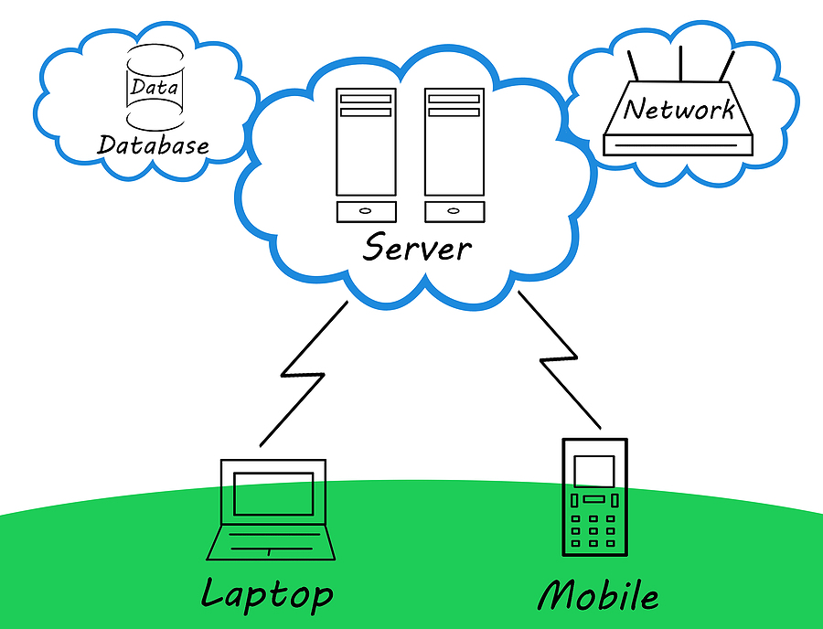
Desktop Virtualization and Thin Client
Desktop virtualization
Reduce Energy Consumption
Decrease cost of maintenance and management

Slide 27
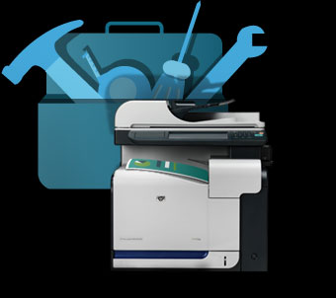
Printer Consolidation
Research focuses on :
  Decreasing consumables such as paper, toner, ink and energy are driving forces behind printer consolidation and reduction.
  Reducing maintenance and management costs associated with scattered printer fleets composed of different makes, models and hardware requirements.

Slide 28
Research on ICT Energy Measurement
You can’t manage what you can’t measure. IT is increasingly under pressure to manage energy costs.
Provide evidence for increasing efficiency in existing and future IT practices.
Measure server room consumption.
Firms find it necessary to have quantifiable results as part of their answer.

Slide 29
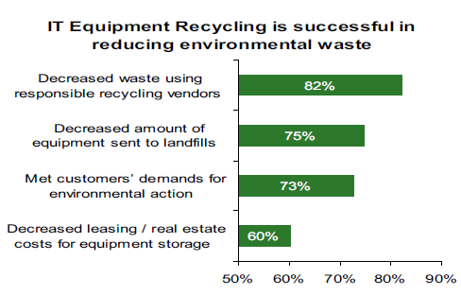
ICT Asset Disposal
The success of ICT equipment recycling relies not on a business case with cost savings, but on a combination of environmental responsibility and regulatory pressures.

Slide 30
Key Success Factors for Green ICT Projects
Stakeholder Support
Overcome barriers such as inadequate funding, misalignment with physical facilities, and a lack of resources, such as IT staff, can all be barriers.
Economic Tradeoffs

Slide 31

of Green ICT
Enhanced Geothermal Systems
Nanosolar
Orbiting solar arrays
Concentrated Solar Power
Smart Grids
Carbon Capture & Storage
Nuclear Fusion Power

Slide 32

Conclusion
It’s high time that Mauritius also embarks in research on Green ICT
As first stage research focus in the Mauritian context should be :
  Investigating on awareness of Green ICT
  Studying energy consumption of IT equipment
  Policy building
  IT asset disposal
Mauritius Researchers should be encouraged to embark on research and collaborate in projects related to Green ICT through proper funding

Slide 33
Reference
Green ICT : Technologies and Applications, Springer-Verlag Berlin Heidelberg, 2011
Symantec Green ICT report, 2009
Green ICT: Why Mid-size Companies Are Investing Now INFO-TECH RESEARCH GROUP

